Slide 1
Java Basic Data Types

Slide 2
Java Basic Data Types
Variables are nothing but reserved memory locations to store values.
This means that when you create a variable you reserve some space in memory.
Based on the data type of a variable, the operating system allocates memory and decides what can be stored in the reserved memory
Therefore, by assigning different data types to variables, you can store integers, decimals, or characters in these variables.
There are two data types available in Java
Primitive Data Types
Reference/Object Data Types

Slide 3
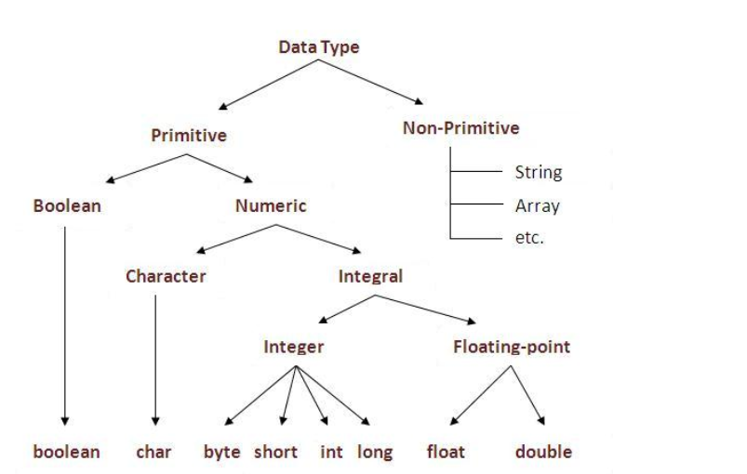
Data types in java

Slide 4
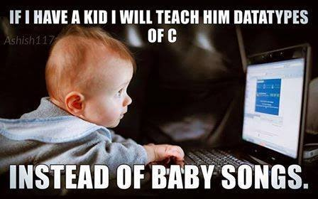

Slide 5
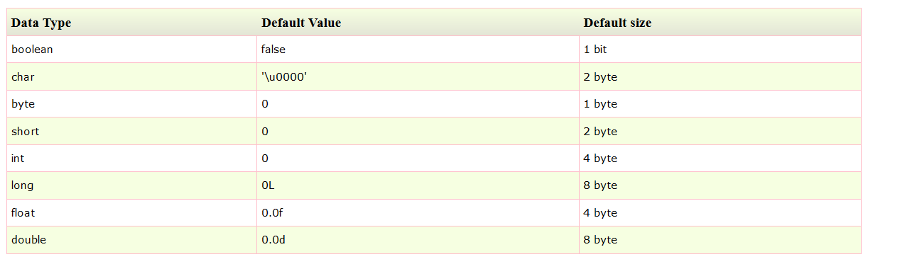

Slide 6
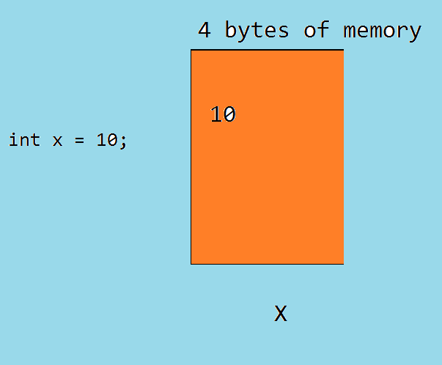
Memory allocation in variables

Slide 7
bit = 1 or 0
1 Byte = 8 bits
1 KB = 1024 bytes
1MB = 1024 KB
1GB = 1024 MB
1TB = 1024GB

Slide 8
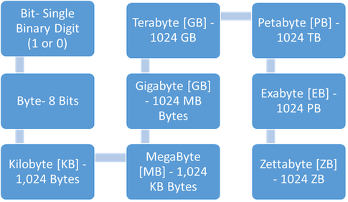
Memory calculation

Slide 9
Primitive Data Types
There are eight primitive data types supported by Java. Primitive data types are predefined by the language and named by a keyword.
byte:
Byte data type is an 8-bit (1 byte) signed integer.
Minimum value is -128 (-2^7)
Maximum value is 127 (inclusive)(2^7 -1)
Default value is 0
Byte data type is used to save space in large arrays, mainly in place of integers, since a byte is four times smaller than an int.
Example: byte a = 100, byte b = -50

Slide 10
short
Short data type is a 16-bit (2 bytes) signed integer.
Minimum value is -32,768 (-2^15)
Maximum value is 32,767(inclusive) (2^15 -1)
Short data type can also be used to save memory as byte data type. A short is 2 times smaller than an int
Default value is 0
Example: short s= 10000, short r = -20000

Slide 11
int
int data type is a 32-bit (4 bytes) signed integer.
Minimum value is - 2,147,483,648.(-2^31)
Maximum value is 2,147,483,647(inclusive).(2^31 -1)
int is generally used as the default data type for integral values unless there is a concern about memory.
The default value is 0.
Example: int a = 100000, int b = -200000

Slide 12
long
Long data type is a 64-bit (8bytes) signed integer.
Minimum value is -9,223,372,036,854,775,808.(-2^63)
Maximum value is 9,223,372,036,854,775,807 (inclusive). (2^63 -1)
This type is used when a wider range than int is needed.
Default value is 0L.
Example: long a = 100000L, long b = -200000L

Slide 13
float
Float data type is a single-precision 32-bit (4 bytes) floating point.
Float is mainly used to save memory in large arrays of floating point numbers.
Default value is 0.0f.
Float data type is never used for precise values such as currency.
Example: float f1 = 234.5f

Slide 14
double
double data type is a double-precision 64-bit (8 bytes) floating point.
This data type is generally used as the default data type for decimal values, generally the default choice.
double data type should never be used for precise values such as currency.
Default value is 0.0d.
Example: double d1 = 123.4

Slide 15
char
char data type is a single 16-bit Unicode character.
Minimum value is '\u0000' (or 0).
Maximum value is '\uffff' (or 65,535 inclusive).
Char data type is used to store any character.
Example: char letterA ='A'

Slide 16
boolean
The Boolean data type has only two possible values: true and false.
This data type represents 1 bit of information but its size is not precisely defined
true, false are keywords and literals.
Default value of Boolean datatype is false
boolean b = false;

Slide 17
Reference Data Types
Reference variables are created using defined constructors of the classes. They are used to access objects. These variables are declared to be of a specific type that cannot be changed. For example, Employee, Puppy, etc.
Class objects and various types of array variables come under reference data type
Default value of any reference variable is null
A reference variable can be used to refer to any object of the declared type or any compatible type.
Example: Animal animal = new Animal("giraffe");

Slide 18
Data type declaration
Syntax: datatype variableName;
Ex: int i; long l; float f; double d; char c; boolean b;

Slide 19
Initialization
It is nothing but assigning value to the variable
Ex: int i=10; char c=‘A’; boolean b = true;

Slide 20
Declaration and initialization
Int i=10;
float f=10.24f;
boolean b = true;
char c =‘A’;

Slide 21
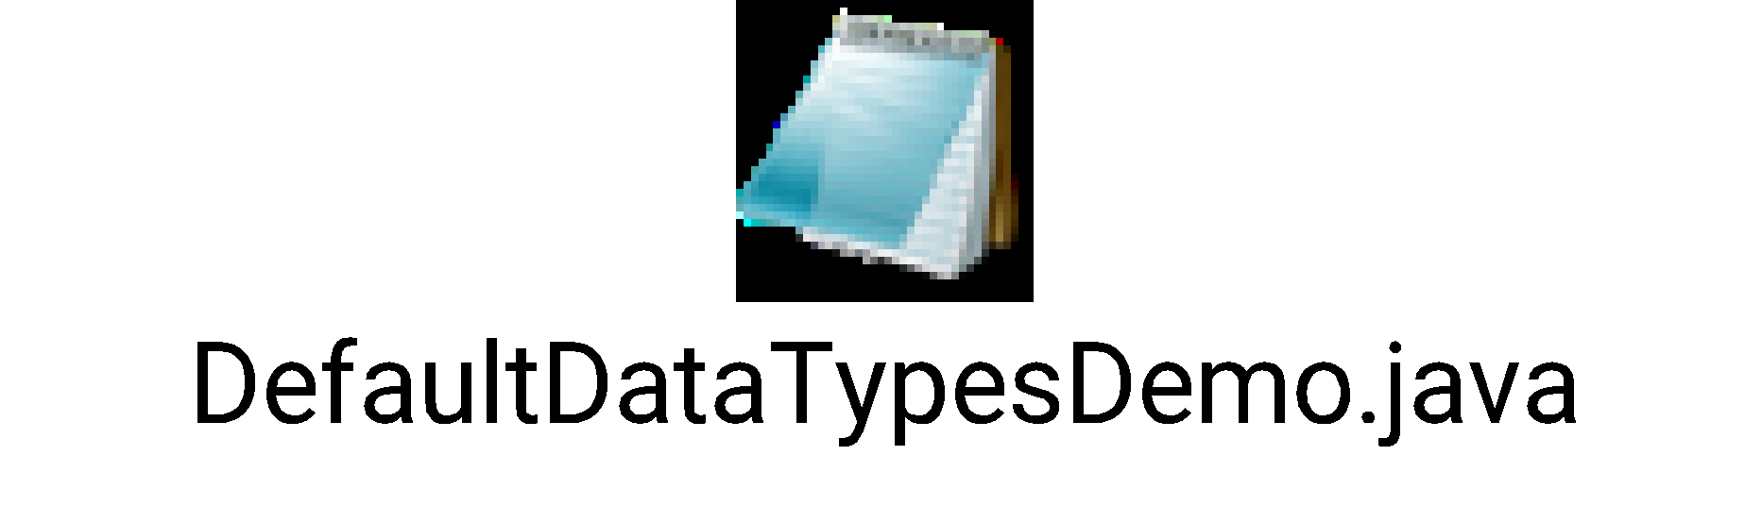
Example Program to print default values of primitive datatypes

Slide 22
public class DefaultDataTypesDemo {
//Integer data types
static byte b;static short s;
static int i;static long l;
//decimal data types
static float f ;static double d ;
//character data type
static char c ;
//boolean data type
static boolean bo;
//reference data type
static String st;
public static void main(String[] args) {
System.out.println("byte b: "+b);
System.out.println("short s: "+s);
System.out.println("int i: "+i);
System.out.println("long l: "+l);
System.out.println("float f: "+f);
System.out.println("double d: "+d);
System.out.println("char c:"+c);
System.out.println("boolean bo: "+bo);
System.out.println("String st: "+st);
}}

Slide 23
Why char uses 2 byte in java and what is \u0000 ?
Java uses Unicode system rather than ASCII code system.
\u0000 is the lowest range of Unicode system.

Slide 24
Unicode System
unicode is a universal international standard character encoding that is capable of representing most of the world's written languages.

Slide 25
Why java uses Unicode System?
Before Unicode, there were many language standards:
ASCII (American Standard Code for Information Interchange) for the United States.
ISO 8859-1 for Western European Language.
KOI-8 for Russian.
GB18030 and BIG-5 for chinese, and so on.
This caused two problems: A particular code value corresponds to different letters in the various language standards.
The encodings for languages with large character sets have variable length. Some common characters are encoded as single bytes, other require two or more byte.
To solve these problems, a new language standard was developed i.e. Unicode System.
In unicode, character holds 2 byte, so java also uses 2 byte for characters.
lowest value:\u0000
highest value:\uFFFF

Slide 26
***Guess the output
public static void main(String[] args)
{
System.out.println("H" + "I");
System.out.println('H'+ 'I');
}

Slide 27
Output
HI
145

Slide 28
